Slide 1
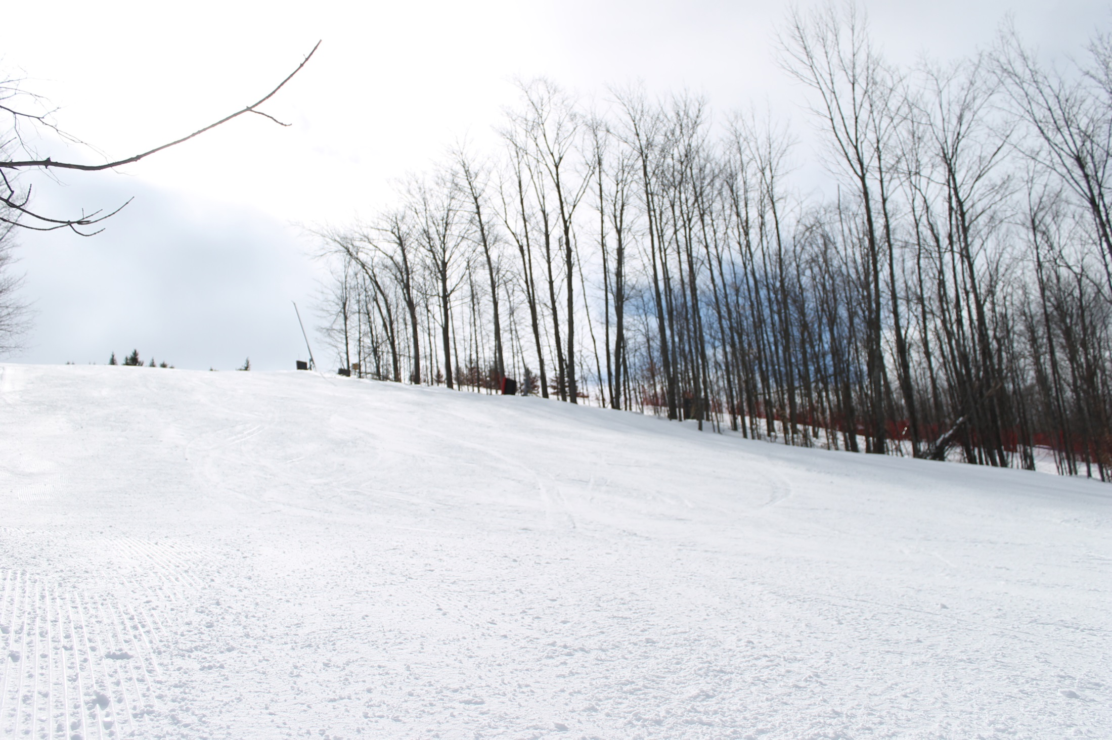

CANADIAN SKI COUNCIL
MARKETING AND RESEARCH
COMMITTEE MEETING
July 4, 2013 11:30 a.m. – 1:30 p.m. E.S.T

Slide 2
 | Agenda
1. | 11:30-11:35 | Call to Order, Approval of Agenda, Chair’s Opening Remarks | Paul Pinchbeck
2. | 11:35-11:45 | Skier Rider Development Program- Brief Results Grade 4 & 5 SnowPass program Total applications received for 2012/13 End of season research 2013/14 SnowPass program | Patrick Arkeveld & Jessica Weis Patrick Arkeveld
3. | 11:55-12:05 | Discover Skiing/Snowboarding End of season results | Laura Rice
4. | 12:05- 12:15 | Canadian Ski Council Media Campaign - Brief Results | Patrick Arkeveld & Natalie Dalzell
5. | 12:15-12:25 | Skier Rider Development Pledge Form Agreements | Patrick Arkeveld
6. | 12:25-1:25 | CSC Internet Marketing Strategy – Next Steps and Recommendations for 2013/14 | Paul Pinchbeck & Laura Rice
7. | 1:15-1:25 | 2013 Toronto Snow Show – Brief Update | Paul Pinchbeck & Patrick Arkeveld
8. | 1:25-1:30 | Time and Place of Next Meeting | Paul Pinchbeck
9. | 1:30 | Meeting adjournment | Paul Pinchbeck

Slide 3
July 4, 2013 11:30 a.m. – 1:30 p.m. E.S.T
2. Skier Rider Development Programs

Slide 4
2012/13 SnowPass Results
www.skicanada.org

Slide 5

Preliminary Results
Canada
2011/12
Areas Participating
154
156
Applicants
28,139
29,772
No prior experience
18%
17%
Used the Pass 1+ times
77%
78%
Visits
62,999
57,993
Notes:
Areas participating – consistent with last few years though down 2 nationally and 4 in the west
Applicants – down 4% nationally, 2% in the west
No Prior Experience – up nationally 17.1 to 18.4% no prior experience and up in the west from 18.3 to 19.3
Activation (used pass 1+ times) went down marginally Nationally from 78% to 77% and substantially in the West 77% to 70%

Slide 6
Historical Participation
Need to better understand what the target participation number is
Need to understand the true opportunity
Will greater advertising truly raise participation levels?
Penetration #’s have only ever looked at the one year
Down ≈ 10% in Ontario, primarily due to lack of school participation
Notes:
Looking at participation over the course of the programs history.

Slide 7
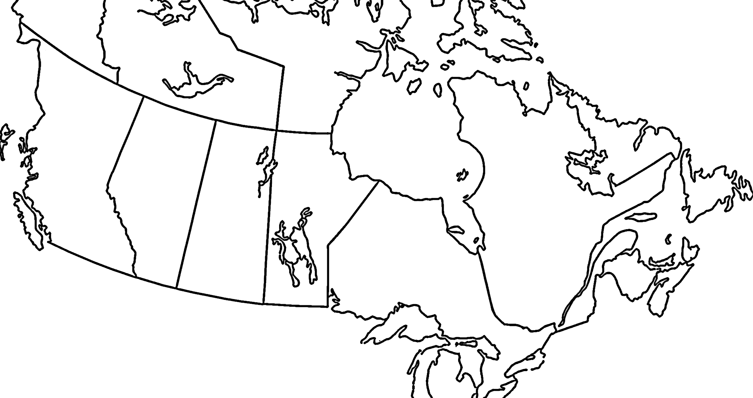
Market Penetration
3.9% of 9-10 year olds applied for a SnowPass™ this season.
Of the main provinces BC has the highest penetration, Ontario the lowest
Notes:
This is only applications. Does not consider carry overs
Note – I believe this is comparable to what you called market share last year – however it is not 3.9% but 39 per 1000 – this
Applications/1000 9-10yr olds
CAN 39
West 49
YK 18
BC 73
AB 54
SK 3
MB 3
NT 3
Ont 27
ON 27
Quebec 55
QC 55
East 6
NB 7
NS 8
PE 3
NL 3

Slide 8
Activation Rate
77% of applicants used their SnowPass at least once
Activation was highest in Quebec
Notes:
Activation (Used 1+ times)
FY13 FY12
CAN 77% 79%
West 70% 76%
BC 68% 74%
AB 73% 80%
SK 82% 85%
MB 82% 79%
YK 50% 0%
NT 100% 100%
Ont 76% 75%
ON 76% 75%
Quebec 86% 86%
QC 86% 86%
East 58% 54%
NB 67% 74%
NS 59% 48%
PE 70% 83%
NL 11% 4%

Slide 9
Participant Analysis
This ‘trend’ is consistent over the past 3 years
Average days skied 2008/09 = 4.99
Average days skied 2009/10 = 3.36
Average days skied 2010/11 = 4.71
10+
2008/09
2009/10
2010/11

Slide 10
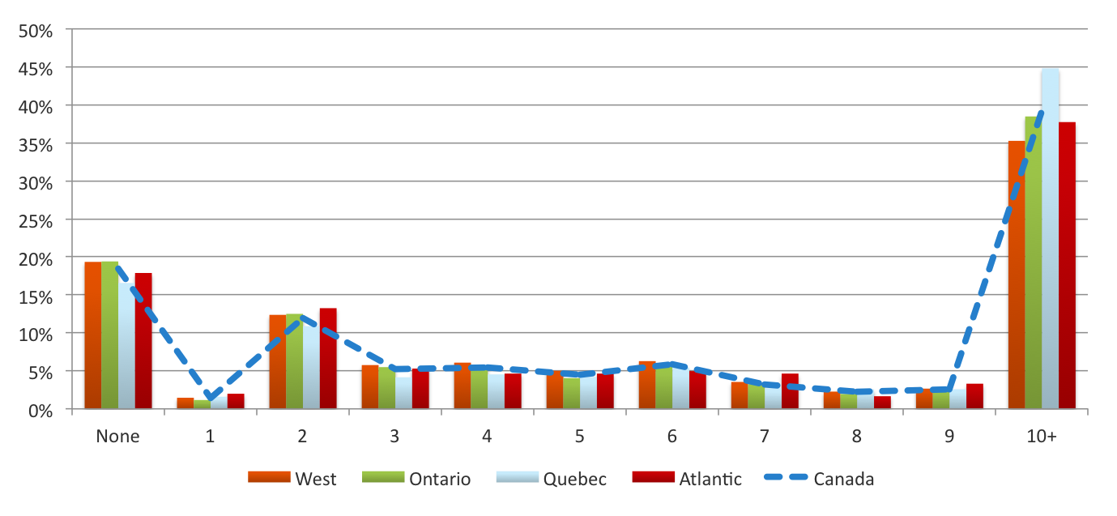
Prior Experience
Almost one in five applicants were new to snowsports, a similar share had tried skiing or snowboarding and were infrequent participants
Active
45% ≤ 5 times in the past
36% ≤ 3
Never
Infrequent
Notes:
This year we were able to capture more concise data with respect to participants past experience
As mentioned, approximately 20% of all applicants have never put on a pair of skis
Among those with experience, half indicated they had skied OR snowboarded 10+ times in the previous year.
Prior Experience - # times skied/boarded in previous year
Total % times ski/board last year
Canada West Ontario Quebec Atlantic
None 18% 19% 19% 17% 18%
1 1% 1% 1% 2% 2%
2 12% 12% 13% 11% 13%
3 5% 6% 5% 4% 5%
4 5% 6% 6% 5% 5%
5 4% 5% 4% 4% 5%
6 6% 6% 6% 5% 5%
7 3% 4% 3% 3% 5%
8 2% 2% 2% 3% 2%
9 3% 3% 2% 3% 3%
10+ 39% 35% 38% 45% 38%
10 TIMES 4% 3% 3% 6% 3%
11 TIMES 28% 25% 29% 31% 27%
12 TIMES 1% 1% 1% 1% 2%
13 TIMES 1% 1% 1% 1% 1%
14 TIMES 1% 1% 0% 1% 1%
15 TIMES 1% 1% 1% 1% 1%
16 TIMES 0% 0% 0% 0% 1%
17 TIMES 0% 0% 0% 0% 1%
18 TIMES 0% 0% 0% 0% 0%
19 TIMES 0% 0% 0% 0% 0%
20 TIMES 3% 2% 3% 4% 2%

Slide 11
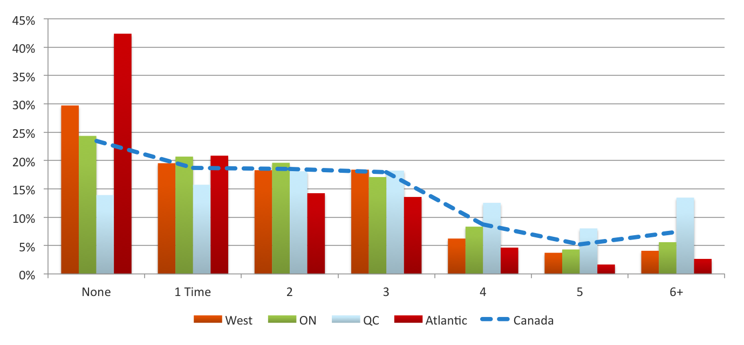
Actual Usage
While a small share of applicants used the SnowPass more than 5 times, this was driven by active pass holders in Quebec
< 1% use pass greater than 10 visits
< 8% use the pass greater than 5 visits
Notes:
# Times Used the pass
# Times Canada West BC AB ON QC East
None 23% 30% 32% 27% 24% 14% 42%
1 Time 19% 20% 20% 19% 21% 16% 21%
2 19% 18% 18% 18% 20% 18% 14%
3 18% 18% 19% 17% 17% 18% 14%
4 9% 6% 5% 7% 8% 13% 5%
5 5% 4% 3% 5% 4% 8% 2%
6 3% 2% 2% 3% 3% 5% 2%
7 2% 1% 1% 1% 1% 3%
8 1% 0% 0% 0% 1% 2% 0%
9 1% 0% 0% 0% 0% 1%
10+ 1% 0% 0% 1% 0% 1% 0%

Slide 12


Marketing Strategy
www.skicanada.org
Notes:
So how are we targeting these individuals?
We advertised the program for the first time.

Slide 13
Marketing Strategy
Print Advertising
Targeted Online Advertising
PPC Campaign
Targeting Postal Code Drop
Staged Press Releases
Social Media
First time the CSC has actively advertised the program
Remains a sensitive issue for many ski areas
Recent research allowed us to work from the same set of assumptions
Additional funds raised from price increase allocated to advertising the program
Results include pent up demand from families with children under the age of 9
Advertising Campaign
Notes:
The CSC has never advertised the program. We had no experience to know what works well and what doesn‘t, we begin the printing and program process in the spring, making it somewhat difficult for us to respond to what our research told us, so it was a bit of a trial year to a certain extent when it came to our advertising strategy.
We work with a couple different agencies in an effort to put some programs in place that were very specific to our target audience.
There was concern to those areas who cater primarily to children that this would be used as an alternate to a seasons pass

Slide 14
Print Media
National Post - Two ½ page ads – Saturday Edition (Dec 1/8)
Enroute Magazine – Full page ad – December Issue
LEARN Magazine – 1/6 page ad – Winter 2012
Professionally Speaking – 1/6 page ad – Winter 2012
EPOCH Times – Three ¼ page ads – Saturday Edition
EPOCH Times – Holiday Gift Guide - November
Sport Chek Flyer – Two Issues - Nov 28 - Dec 10
Ontario Winter Guide – Full page ad – Winter 2012
Canadian Forces Appreciation Program – Winter 2012/13
Total Circulation > 10,000,000
Notes:
With regards to print media
National Post = 171,942 Circulation
Enroute = 118,000 circulation, 942,000 readership
Learn Magazine = 67,000 readership
Epoch Times = 116,500
Sport Chek = 5,000,000 per issue

Slide 15
Editorial
8 Press releases issued to over 12,000 media contacts YTD
Highlighted in 98 publications as of March 7, 2013
Series of radio interviews across the country as a result
Total circulation of 8,889,629 vs. 1,160,480 in total for 2011/12
Very low cost method of raising awareness
Picked up during March Break segment on Breakfast Television - Toronto
Notes:
Targeted “themed” releases issued over the past couple of months.
List is bought from Cision, Cision tracks

Slide 16


Pay Per Click
Google ad words campaign (Oct – Feb)
2,502 Clicks – 1,112,983 Impressions as of April 1, 2013
Two campaigns:
    Kids learn to ski ≈1,500 clicks, 950,000 impressions
    Kids active Living ≈1,000 clicks, 160,000 impressions

Slide 17
Targeted Online Advertising
Pilot project initially launched in Quebec only
Later followed up with a campaign in Ontario due to school issues
Behaviour targeting based upon previous browsing history
Banners went through a channel of >400 websites such as: aircanada.ca, lactualite.ca, chatelaine.com etc.
When browsing the web, the site will put a cookie on a browser, which populates as one surfs
Achieved 16,000 clicks and 19,764,059 impressions during a 1 month period of Quebec campaign
Achieved 10,529 clicks and 5,602,619 impressions during 3 week period of Ontario campaign

Slide 18
Postal Code Drop
Direct mail piece sent to 205,000 HHS across Canada
Based upon the following criteria:
    100% of HHS within our two target groups
    No more than 5% of households participated previously
    A high % of children within our target age demographic
    Within 1.5 hours of a ski area
Results will be carefully evaluated based upon analysis of application postal codes to determine effectiveness of campaign

Slide 19
Marketing Strategy - Impact
Marketing Campaign Launch
≈ 26% increase in web traffic since launch of advertising campaign
≈ 215,999 site visits since September 1st, 2012 (up until March1st, 2013)
Averaging approximately 1700 visits/day during winter months
Average visit duration of 4:08 min (excluding application process)
Approximately 67% of visits are unique (72% on passpsortdeneiges.ca)

Slide 20
Marketing Impact
There are some differences geographically – likely a result of local marketing efforts
 | Canada | West | BC | AB | ON | QC | Atlantic
School | 54% | 116 | 118 | 116 | 82 | 96 | 66
Friends/Family | 33% | 80 | 81 | 77 | 120 | 107 | 123
Web/Social | 4% | 78 | 70 | 83 | 112 | 116 | 151
Retail | 3% | 88 | 77 | 97 | 120 | 94 | 224
Ski Area | 2% | 95 | 63 | 126 | 108 | 92 | 301
Print | 1% | 37 | 24 | 54 | 179 | 108 | 215
Event | 0% | 60 | 39 | 91 | 216 | 51 | 0
Other | 3% | 94 | 97 | 88 | 127 | 84 | 90
Notes:
Now the important part is tracking and measuring our success.
Determining what gets traction and what doesn’t

Slide 21
Marketing Impact
There were also some differences in the postal walk assessment with higher take ups in Ontario and Alberta. Overall 10% increase in participation within targeted market
 | Canada | West | BC | AB | ON | QC | Atlantic
Postal Walk Delivery Area
In target area | 4.3% | 4.5% | 4.0% | 5.4% | 6.2% | 2.6% | 1.0%
School Catchment Areas
In area | 82% | 81% | 83% | 80% | 86% | 80% | 41%
Notes:
SPEAKING NOTES
Need to find new
Canada West BC AB ON QC East CA INDEX to FY12
POSTAL WALK MARKETS
WITHIN POSTAL WALK 4.3% 4.5% 4.0% 5.4% 6.2% 2.6% 1.0% 115 +10% chg to LY
NOT IN POSTAL WALK 94.1% 93.8% 94.3% 93.0% 92.3% 96.1% 96.0% 100 - 4% chg to LY
NOT AVAILABLE 1.5% 1.6% 1.7% 1.6% 1.6% 1.4% 3.0% 75 - 28% chg to LY
SCHOOL MARKETING AREA
IN SCHOOL MARKET 82% 81% 83% 80% 86% 80% 41% 100 - 4% chg to LY
NOT IN SCHL AREA 18% 19% 17% 20% 14% 20% 59% 99 -5% chg to LY

Slide 22
Ski Area Promotion
93% of all participating ski areas currently have no mention of the SnowPass program on their website
Need the support of the individual ski areas to help raise awareness
If we believe in the results of the program, everyone needs to help promote it
Less than 1% of participants learnt about the program from local ski area
Notes:
Don’t want to sound like I am nagging.

Slide 23
Future Changes
www.skicanada.org

Slide 24
2013/14 Proposed Changes
Improve the overall distribution of the program (beyond schools)
Build upon existing relationships with schools
Provide ski areas with access to their year end data
Provide ski areas with year end usage analysis
Focus marketing strategy on targeting beginners
Increase the overall awareness of the program (internal/external)
Strong push for additional sponsors (in conjunction with rebrand)
Currently working with Health Canada regarding support/funding
Notes:
BC and Alberta do a very good job of engaging local schools.
The potential project should focus on an "intervention" of some kind to help prevent chronic disease and promote healthy living. This is what we need to explore...how do we scale up or adapt the CSC program (Snow Pass or another program) to fit the PHAC intervention project that will help prevent chronic disease and promote healthy living.
Projects to be funded under the PHAC initiative must include a focus on at least one of the following:
addressing healthy living and healthy weights through a primary prevention initiative
addressing common risk factors (i.e. unhealthy diet, physical inactivity, tobacco use) applicable to a number of the aforementioned chronic diseases

Slide 25
Access to Data
Provide ski areas access to the data
Provide regional analysis of participation habits
Individual resort analyses available where possible
    > 300 unique visitors
Provide ski areas with contact info of those that visited their area in order to allow them to market the next option for them

Slide 26
3. Discover Skiing & Snowboarding
2012-2013 Season Results
Total Ski Areas participated 102
Number of Results reported from ski areas 56 (55% response rate)
up from 2011-2012’s response rate of 40/116 (34.5%)
Of those 56 ski areas who responded:
Discover Skiing packages sold 35,285
Discover Snowboarding packages sold 17,218
Discover X-Country packages sold 353
Total 53,739

Slide 27
Discover Skiing & Snowboarding
2012-2013 Season Results
Approximate total # of Discover packages sold across Canada
Discover Skiing 64,269
Discover Snowboarding 31,361
Discover Cross-Country 1,608
For a total of 97,239 Discover Packages sold across
Canada in 2012-2013 (Up from 73,745 in 2011-2012)

Slide 28
Discover Skiing & Snowboarding
2013-2014 Season
  Will move the Discover Skiing and Snowboarding section over to the goskiinggosnowboarding.ca for a cleaner and updated look.
  Will provide ski areas with logos, buttons and links to place on their website.
  Generate more social media and blog content to keep the name in circulating
Interesting stats
38 out of 53 (72%) responding ski areas offer helmets with their Discover Packages
94% of respondents advise they advertise their Discover Packages. Website and ski area brochures being the most often used advertising choice.

Slide 29
July 4, 2013 11:30 a.m. – 1:30 p.m. E.S.T
4. Canadian Ski Council Media Campaign

Slide 30
4. Canadian Ski Council Media Campaign
Media campaign results comparison of 2011/12 and 2012/13
 | Total number of clippings 2012/13 | Total number of clippings 2011/12 | Percentage increase/ decrease | Circulation/Reach 2012/13 | Circulation/ Reach 2011/12 | Percentage increase/ decrease
Grade 4 & 5 SnowPass | 106 | 73 | 45.2% | 9,646,033 | 13,061,447 | -26.0%
Discover Skiing / Snowboarding | 18 | 13 | 38.5% | 1,160,480 | 306,046 | 279.2%
Web site mention/CSC | 9 | 4 | 125.0% | 19,301,756 | 105,009 | 18281.0%
Helmets | 17 | 26 | -34.6% | 18,021,960 | 8,838,499 | 103.9%
Total: | 150 | 116 | 29.3% | 48,130,229 | 22,311,001 | 115.7%
Notes: 2011/12 SnowPass circulation includes a small mention online on MSN Canada with a reach of 12,000,000 which accounts for 92% of the total circulation for the 2011/12 season. If you remove this, the total circulation/reach for 2011/12 is 1,061,447.

Slide 31
July 4, 2013 11:30 a.m. – 1:30 p.m. E.S.T
5. Skier Rider Development Pledge Form Agreements

Slide 32
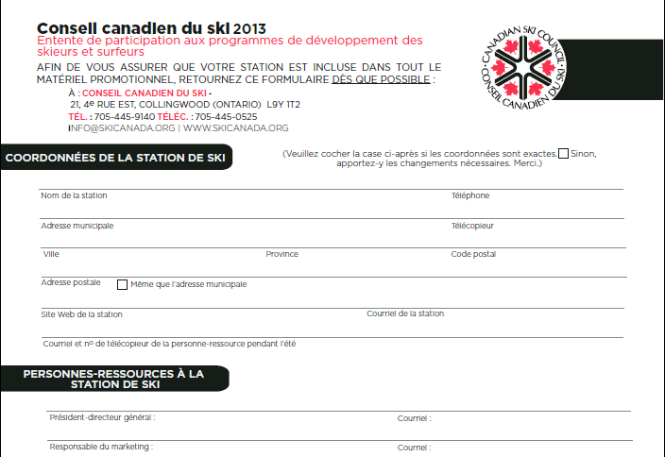
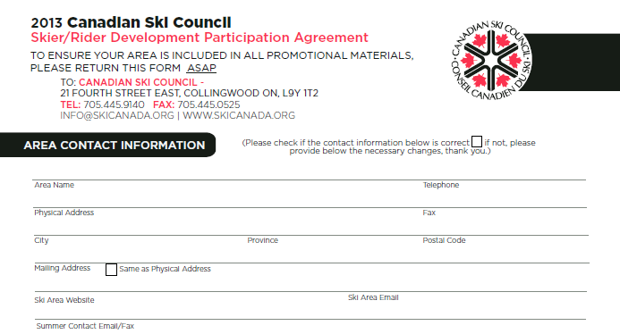

Slide 33
Updated Pledge Process
Introduce opt out process as opposed to annual pledge
Will greatly help to reduce the overall administrative cost
Will help free additional resources to promote the program
Will allow the online application process to begin much earlier
Will allow us to plan the printing/design etc. more effectively
Will help in our efforts to attract major sponsors
Ski areas will remain in the program unless we are notified otherwise
Ski areas will be notified in writing twice each year of the deadline to opt out
Notes:
As a non-profit organization, we are always looking at how we can decrease our administrative cost in order to maximize the resources we have available to us.

Slide 34
July 4, 2013 11:30 a.m. – 1:30 p.m. E.S.T
6. CSC Internet Marketing Strategy

Slide 35

Agenda
Current CSC URL Inventory
Current CSC Website Visits
Comparison of Go and Skicanada.org
Site amalgamation plan
Mock up of end result desired

Slide 36
Current Website Inventory and forwarded domains
CSC Industry/Consumer website
  www.skicanada.org
  www.canadianskicouncil.org www.canadasnowboard.org
  www.conseilcanadienduski.org
  www.winterfeelsgood.ca
Grade 4 & 5 SnowPass website
  www.snowpass.ca
  www.passeportdesneige.ca
  www.passeportdesneige.org
  www.snowpass.org
Go Skiing Website
  www.goskiinggosnowboarding.ca
  www.goskiinggosnowboarding.org
  www.vivelaneige.ca
  www.gosnow.org
  www.go-skiing.ca
  www.go-snowboarding.ca
  www.vivelaneige.ca
My Helmet Website
  www.myhelmet.ca
  www.myhelmet.org
Making Winter Winners
  www.makingwinterwinners.ca
  www.makingwinterwinners.org
  www.aidonsnosathletes.ca
  www.aidonsnosathletes.org
Domains we own but are currently not forwarded
  www.discoverwinter.ca
  www.discoverskiing.org
  www.discoversnowboarding.org
Snow Show Website (future)

Slide 37
Current Site Visits| Pageviews (Oct 1/12 – Mar 31/13)
Visits Pageviews
Skicanada.org - 94,769 183,348
  Homepage - 34,594 42,972
  SnowOnline - 2,394 8,318
  Discover – 1,316 3,736
  About the CSC – 236 1,768
SnowPass.ca - 151,271 379,221
  Homepage - 106,456 124,393
MyHelmet.ca - 994 1,189
  Homepage - 973 1,113
Goskiinggosnowboarding.ca 1,354 5,330
( 12/3/12 – 03/31/13)
  Homepage – 678 1,103
  Ski Area Search – 15 254
  Contests – 66 146
  Blog - 15 144

Slide 38
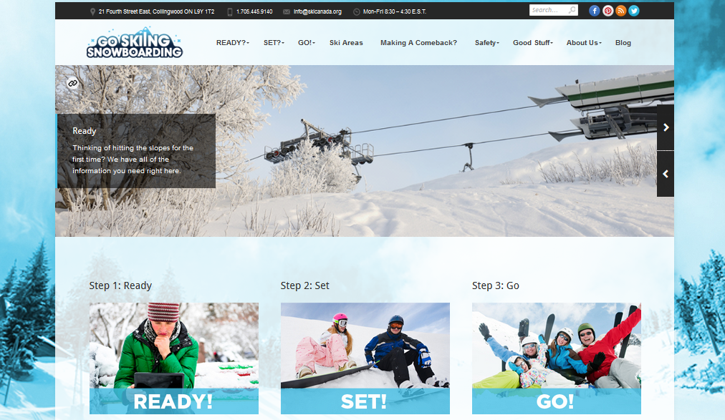
Look and feel that represents the Ski Industry
YES!
Web presence and rankings with search engines
LOW
WOAH!!
That’s a
long URL!
WWW.GOSKIINGGOSNOWBOARDING.CA

Slide 39
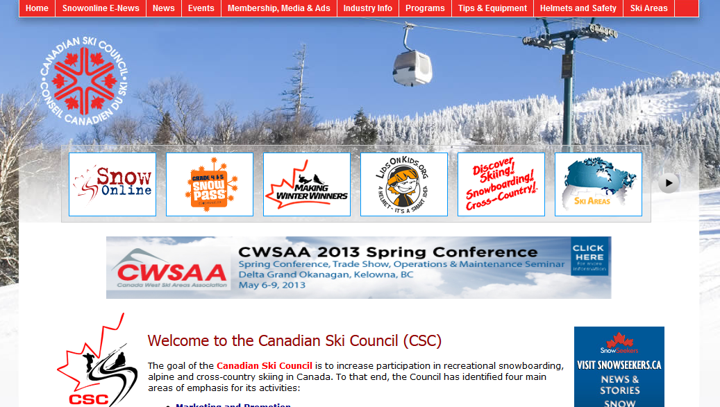
Web presence and rankings with search engines
HIGH
Look and feel that represents the Ski Industry
NO WAY!
WWW.SKICANADA.ORG

Slide 40

HERE’S THE PLAN
COMBINE ALL OF THE NUMEROUS CSC WEBSITES UNDER ONE BANNER
WWW.SKICANADA.ORG
USE GOSKIING WEBSITE ARCHITECTURE FOR NEW SKICANADA.ORG
COMBINE, UPDATE, REWRITE AND ADD NEW CONTENT
MAKE IT SEO FRIENDLY

Slide 41
The New Skicanada.org
www.snowpass.ca
/AboutUs
/Discover
/GoSkiing
GoSnowboarding
/My Helmet
/SnowPass
/MakingWinter Winners
/SnowOnline
www.goskiing
gosnowboarding.ca
SKICANADA.ORG
/SkiShow
www.toronto
skishow.ca/

Slide 42
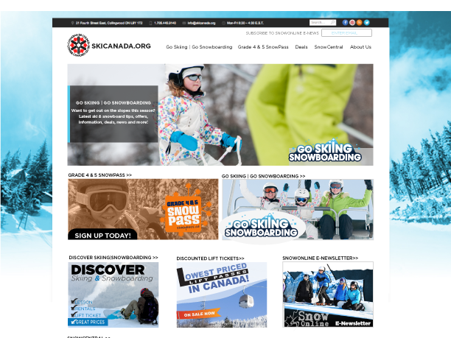
EST VOILA!

Slide 43
July 4, 2013 11:30 a.m. – 1:30 p.m. E.S.T
7. 2013 Toronto Snow Show

Slide 44
July 4, 2013 11:30 a.m. – 1:30 p.m. E.S.T
8. Time and place of next meeting

Slide 45
July 4, 2013 11:30 a.m. – 1:30 p.m. E.S.T
9. Meeting adjournment

Slide 46
July 4, 2013 11:30 a.m. – 1:30 p.m. E.S.T
Appendix

Slide 47
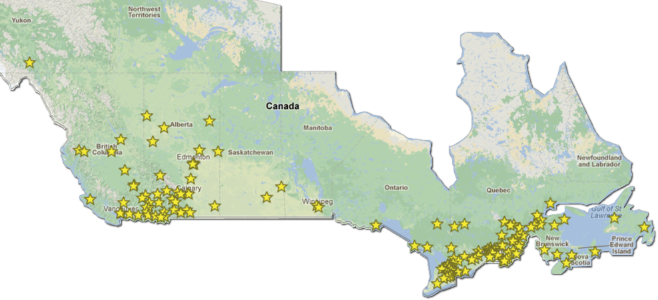
Ski Areas Visited
Overall, SnowPass applicants visited 75% of participating resorts.
Visitation was highest in Quebec – 94.5% of participating resorts seeing a SnowPass holder
Notes:
Speaking Notes
Participating Resorts Visited Resorts Take-Up (Activation)
# Participating % # Visited % %
CAN 155 100% 116 100% 75%
West 56 36% 39 34% 70%
YK/ NT 1 1% 0 0% 0%
BC 32 21% 25 22% 78%
AB 19 12% 12 10% 63%
SK/MB 4 3% 2 2% 50%
ON 34 22% 20 17% 59%
QC 57 37% 52 45% 91%
East 8 5% 5 4% 63%

Slide 48
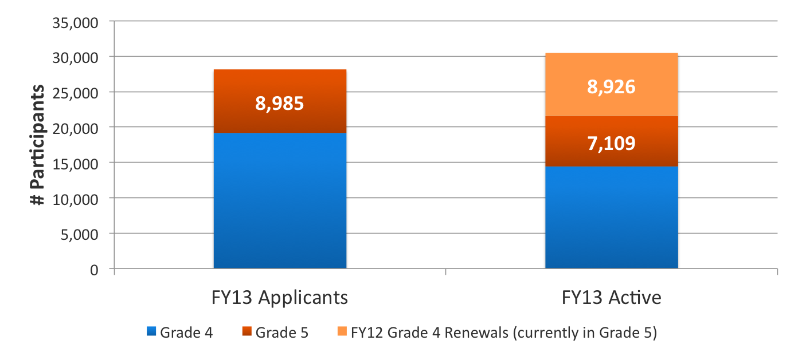
Active Participants
Moving to a two year pass provided an easier continuation for last year’s Grade 4 participants wanting to use their pass this year.
30,456
19,154
14,421
Notes:
Up to this point we have been talking about applicants
However there were an additional 9k participants from last year who were also eligible and active this year 28,399+8,926 = 38,325
Note – the numbers shown are ACTIVE participants and therefore are not comparable to the combined #’s provided in last year’s report which were people who applied
Total ACTIVE passholders = 30,456

Slide 49
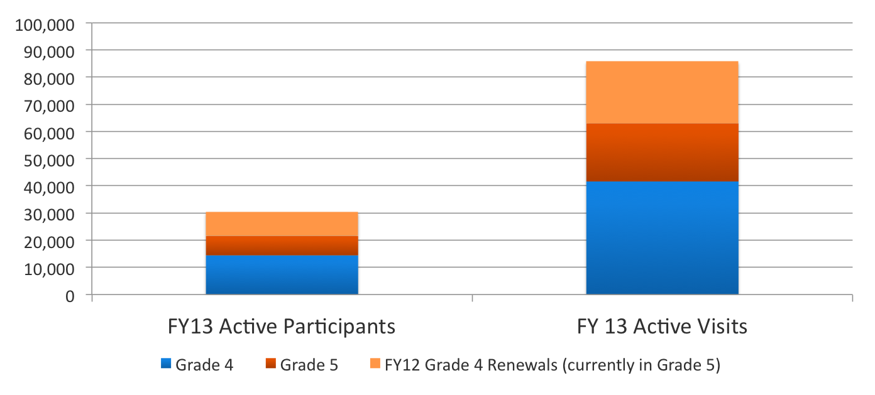
Active Participants
In total there were 30,456 active participants who made 85,992 visits to participating areas
85,922
30,456
Notes:
Compared to approximately 70,000 visits made last year in total (including carry overs)

Slide 50
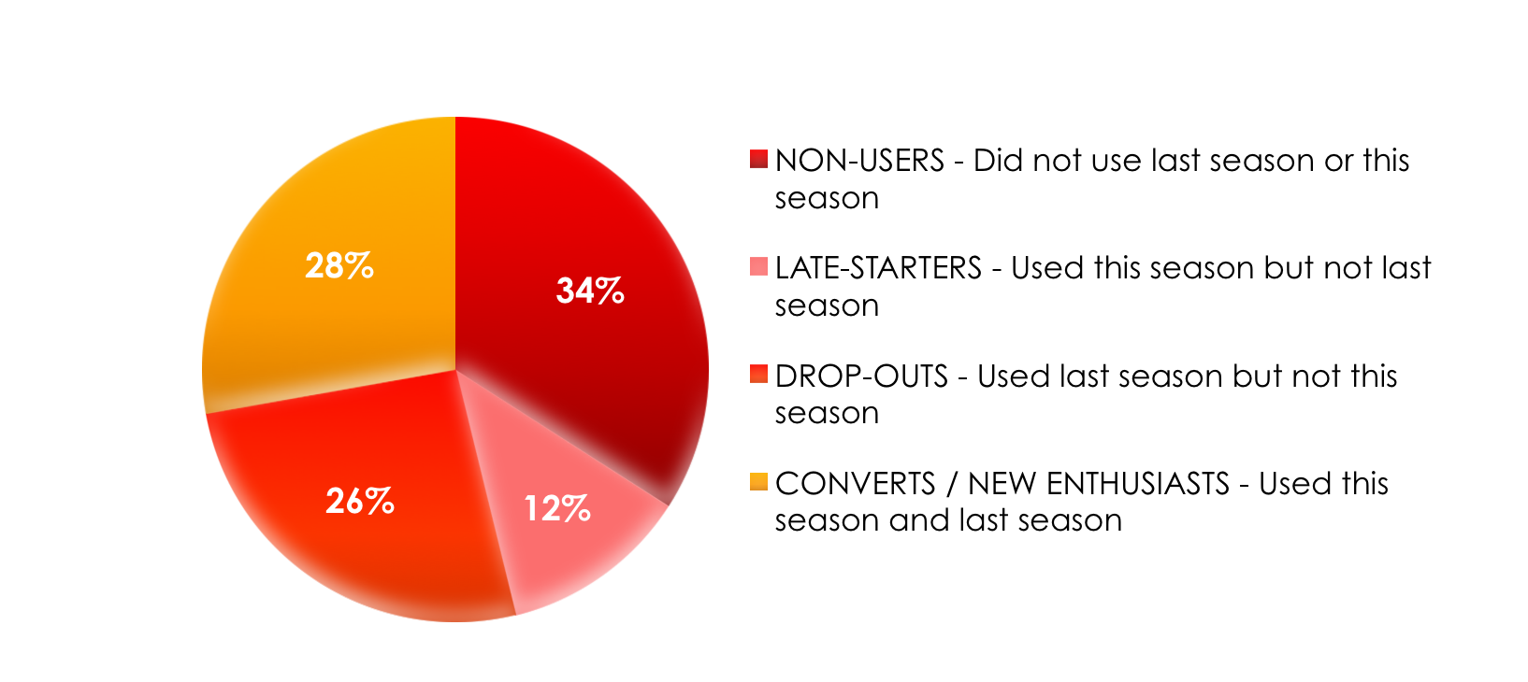
Of the Grade 4 applicants from 2011-12 with no experience – 28% look to be snowsport enthusiasts having been introduced to the sport in 2011-12 and continued to participate in 2012-13
Last Year’s Beginners
Non active users may still be participating, but are not using the SnowPass to do so
40% Active Users
Notes:
Indicator of the programs success in converting first-timers to enthusiasts
Can also mention that the more they use the pass in the first year the more likely they are to use it in grade 5 (next slide – just not sure you need to put the slide up)

Slide 51


Grade 4&5 SnowPass
New Major Sponsor
Additional contribution of weekly prizes

Slide 52
Deciding who to target?
Core Markets
  Upper-middle class families predominantly skiers
Suburban Families
  Families with kids at home and a tendency to be beginners over core
Quebec Affluent Francophone Families
  Upper-Middle families with higher percentage of existing core
Quebec Middle Class Francophone Families
  Families with kids at home and a tendency to be beginners over core
Potential Markets
  Families with kids at home but moderate representation in database
Notes:
All clusters were categorized into 5 “Target Groups” representing 27 of the total 66 clusters with the remaining clusters falling into a final “Non-Target Clusters” group
EA used these profiles to create target groups that had commonalities among the variables used to drive the segmentation
Where possible EA mapped these groups back to life stage and lifestyle so that the resulting groups could be more homogeneous
5 Target groups were identified based on cluster distribution of participants
Two groups (one French, one English) tended to be more experienced skiers & snowboarders, two were skewing towards being beginners, and one group was identified as a group that have not participated but could be a potential market
We decided to focus on those that skewed towards being beginners
Why Target them?:
Skew more towards being ‘beginner’ skiers/snowboarders
Allow us to execute a more targeted campaign
Rich insights help to better craft message, creative and offer
Fish where the fish are: Which markets to target
Allows us to allocate marketing and media dollars more effectively

Slide 53
Suburban Families: Leisure and Retail Behaviours
Winter Sporting Activities
Sporting Goods Retailers
Population 12+
*
% shopped in the past year
% Participated in past year
% Own Equipment
% TV Viewing and participated during travel
in past year
CSC Participants’ Prior Experience⁺
Major Retailers
13% of Suburban Family participants have re-applied (100)
Skew more towards being ‘beginner’ skiers/snowboarders than the average CSC SnowPass participant
% shopped
* Index vs. English Canada ⁺ Index vs. All CDN Participants
Source: PMB, Environics Analytics, CSC

